Slide 1

Scaling OpenStack Networking Beyond 4000 Nodes with Dragonflow
Omer Anson (#oanson), Dragonflow PTL @ Huawei
Eshed Gal-Or (#oshidoshi), Chief Architect Open Source @ Huawei

Slide 2
Is neutron Production-Ready?

Slide 3
Highlights from Mirantis Perf&Scale Test (Dec’16)
MOS 9.0 with Mitaka-based Neutron
3 hardware labs were used for testing
The largest lab included 378 nodes
Line-rate throughput was achieved
Over 24500 VMs were launched on a 200-node lab
…and yes, Neutron works at scale!
https://www.mirantis.com/blog/openstack-neutron-performance-and-scalability-testing-summary/

Slide 4
Highlights from Mirantis Perf&Scale Test (Dec’16)
VMs
196
DVR Router
Subnet
VMs
196
DVR Router
Subnet
Configuration
ML2 OVS
VxLAN/L2 POP
DVR
Heat Stack
1
…
Heat Stack
125
Behavior
Compute 1
…
Compute n (n<=378)
ARP tables exploded at 16K VMs (had to be increased)
RabbitMQ & Ceph broke at 20K VMs
Services and agents broke at 24.5K VMs
Integrity test: Successful
https://www.mirantis.com/blog/openstack-neutron-performance-and-scalability-testing-summary/

Slide 5
Is it enough?
Full OpenStack per ~400 servers
Max 24,500 VMs per OpenStack

Slide 6
What if we need Scale?
1,000+ Servers

Slide 7
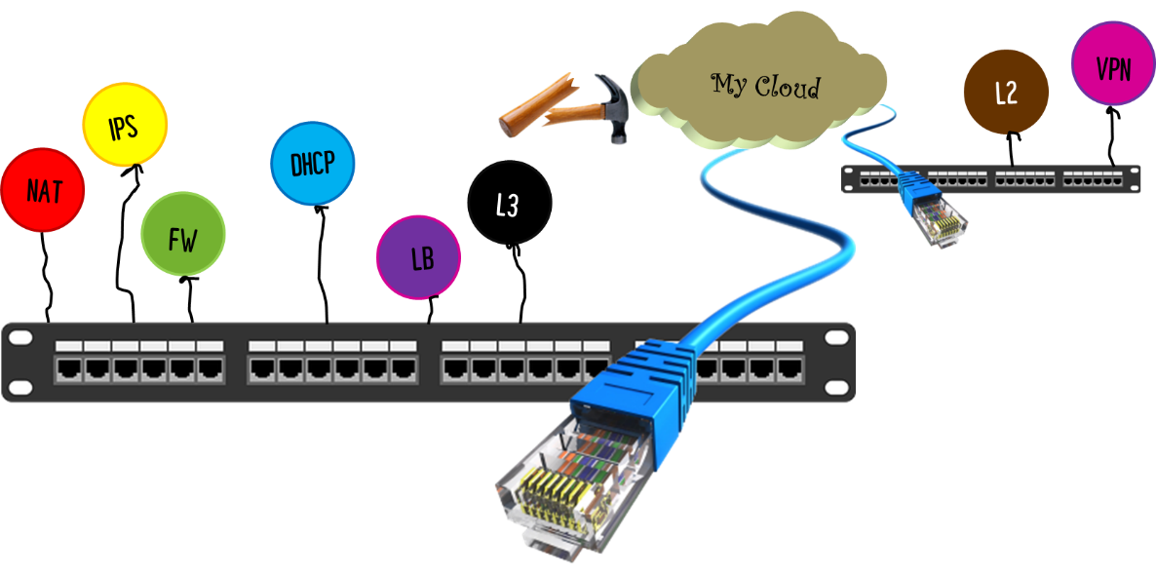

The Problem:
Network Control & Services Break @ Scale

Slide 8
The Solution (for Networking):
Separate “Reads” from “Updates”
Add a scalable “Read Replica” of Neutron DB
Use a well-distributed, well-scaling DB (e.g. Redis)
Lean Distributed Control Plane
Manage small (1) virtual switches in each controller
Controller should be small (e.g. Not Opendaylight)
Distribute Policy (vs. Flows)
Small footprint
Grows with workload (not with infrastructure)
Transformed to southbound at the edge
Distribute Network Services
“Run at edge”
Suppress control messages from going out
Leverage “predefined” nature of cloud env

Slide 9


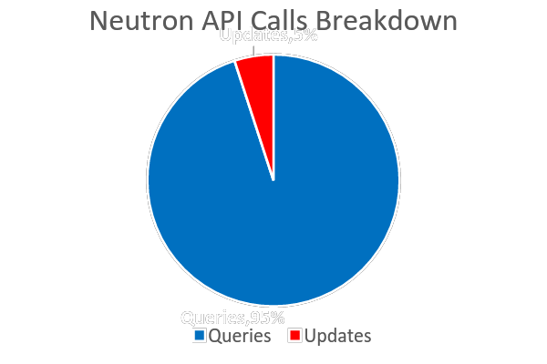
Example: Dragonflow + Redis
Create/Update/Delete/(also some Read)
User
Neutron API
Neutron DB
Neutron Server
Update
Dragonflow ML2 Driver
Pub/Sub
& Queries
DF Controller
DF Controller
…
DF Controller
Openflow
OVS

Slide 10
Distributed Network Services in Dragonflow
Neutron API
Neutron Server
Dragonflow Server
ML2Driver
Service Plugins
DB Drivers
Pub/Sub Drivers
L2
SG
Trunk Port
Router
FW
BGP
LBaaS
TAP
OVSDB
ETCD
Redis
Redis
ØMQ
ETCD
Neutron DB
Network DB
OVSDB
ETCD
Redis
ØMQ
Compute Node
Compute Node
Compute Node
Dragonflow
VM
Pluggable DB
Layer
Dragonflow Controller
OVSDB
NB DB Drivers
Applications
ETCD
Container
Metadata
App
VLAN App
Flat Net App
ICMP App
Remote Port App
Trunk Port
TAP
LBaaS
SB DB Drivers
Redis
New (Ocata)
L2 App
L3 App
DHCP App
SG App
Dist. SNAT App
Active Port Detection
FW
IGMP
smartNIC
OVSDB
ØMQ
Future (Pike+)
OpenFlow
OVS
User Space
vswitchd
OVSDB-Server
Kernel Space
Kernel Datapath Module
NIC

Slide 11
SNAT

Slide 12

Brief Overview (SNAT vs. DNAT)
VM
CN
VM
10.1.11.5
21.3.5.5
DNAT
VM
10.1.13.8
21.3.5.5
CN
21.3.5.7
VM
SNAT
WAN GW
DNAT
WAN GW
VM
10.1.7.7
CN
21.3.8.7
VM
DNAT
SNAT
DNAT

Slide 13
SNAT Implemented in Neutron DVR
https://www.mirantis.com/blog/openstack-neutron-performance-and-scalability-testing-summary/

Slide 14
Distributed SNAT Implemented in Dragonflow
Compute Node
Compute Node
VM
VM
…
NAT #1
Some vRouters
NAT #2
Some WAN Gateways
Internet

Slide 15
Distributed SNAT Implemented in Dragonflow
Compute Node
1
VM
VM
1
2
OVS
qvoXXX
qvoXXX
To the Internet
br-int
2
3
4
5
OpenFlow
Dragonflow
1 | VM Send Packet
2 | Classify Flow as Internet (i.e. not on any of the internal routed networks)
3 | Apply NAT function in OVS with the
4 | Forward packet towards Internet
5 | Possibly, Internet Gateway does 2nd NAT on Packet
Dragonflow Controller
Pluggable DB
Layer
Abstraction Layer
L2 App
L3 App
Dist. SNAT App
…
Distributed
DB

Slide 16
DHCP

Slide 17
DHCP Implementation in Neutron
Neutron Server
Example
100 Tenants
3 vNet / tenant
= 300 DHCP Servers
Message Queue
Network Node
DHCP Agent
DHCP
namespace
dnsmasq

Slide 18
Distributed DHCP Implemented in Dragonflow
Compute Node
1
VM
DHCP SERVER
VM
VM
4
7
1
DHCP DISCOVER
1
2
OVS
DHCP OFFER
3
qvoXXX
qvoXXX
4
br-int
DHCPREQUEST
2
This has everything in it
DHCPACK
6
5
7
OpenFlow
Dragonflow
1 | VM Send DHCP_DISCOVER
2 | Classify Flow as DHCP, Forward to Controller
3 | DHCP App sends DHCP_OFFER back to VM
4 | VM Send DHCP_REQUEST
5 | Classify Flow as DHCP, Forward to Controller
6 | DHCP App populates DHCP_OPTIONS from DB/CFG and send DHCP_ACK
Dragonflow Controller
Pluggable DB
Layer
Abstraction Layer
L2 App
L3 App
DHCP App
…
Distributed
DB
6
3

Slide 19
Dragonflow Benchmark
(Control Plane)

Slide 20
Test Plan
Baseline Neutron
Measure Neutron API-to-DB latency
Baseline Dragonflow
Measure Dragonflow in small environment (1 controller per compute node) – Total 33
4K scale
Measure Dragonflow in large environment (130 controllers per compute node) – Total 4031
Baseline Redis
Measure Redis in large environment (130 agents per compute node) – Total 4031

Slide 21



Baseline Test
Controller
1
Controller
31
Controller
32
br-int
br-int
br-int
DF Server
OVS1
OVS31
OVS32
Server 1
Server 31
Server 32
…
Server 33
Server 38
…
Redis 1
Master DB
Redis 2
Master DB
Redis 3
Master DB
Redis 4
Replica DB
Redis 5
Replica DB
Redis 6
Replica DB

Slide 22
4K scale
Controller
1
…
Controller
130
Controller
1
…
Controller
130
Controller
1
br-int-1
…
br-int-130
br-int-1
…
br-int-130
br-int-1
DF Server
OVS1
Total:
4030 DF Local Controllers
OVS31
OVS32
Server 1
Server 31
Server 32
…
Server 33
Server 38
…
Redis 1
Master DB
Redis 2
Master DB
Redis 3
Master DB
Redis 4
Replica DB
Redis 5
Replica DB
Redis 6
Replica DB

Slide 23
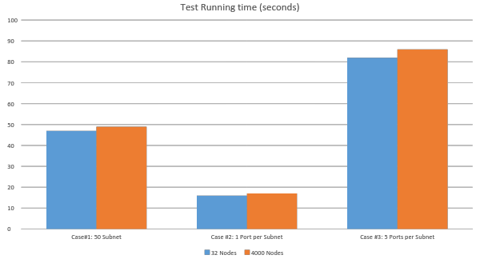
Benchmark Conclusions (single script)

Slide 24
Benchmark Conclusions
Dragonflow performance consistent with scale
Neutron performance needs to improve (need to profile)
Multiple scripts with single Neutron improve 250% (from 1.06 subnet/sec to 2.63 subnet/sec)
Current performance is production ready
Faster than VM spin-up
Comparable to Container spin-up
Scale-agnostic
Redis performance far exceeds the requirements
~177 top-level network events per second, fully synchronized to 4161 nodes

Slide 25
Ride the Dragon
https://wiki.openstack.org/wiki/Dragonflow
https://github.com/openstack/dragonflow
https://launchpad.net/dragonflow
IRC: #openstack-dragonflow
Weekly IRC (Mondays 0900 UTC): #openstack-meeting-4

Slide 27
DATA CONSISTENCY

Slide 28

DB Consistency: Common Problem to all SDN Solutions
CLI / Dashboard (Horizon) / Orchestration Tool (Heat)
Message Queue (AMQP)
Neutron API
Nova API
Neutron-L3-Agent
Neutron-server
Neutron DB
Nova
Services-Plugin
ML2-Core-Plugin
Nova Compute
Nova Compute
Neutron-DHCP-Agent
Service
ML2.Drivers.Mechanism.XXX
Load Balancer
L3 Services
VM
VM
VM
VM
Firewall
VPN
Vendor-specific API
Neutron
Plugin Agent
Neutron
Plugin Agent
SDN Controller
SDN DB
Virtual Switch
Virtual Switch
SDN Apps
North-bound Interface (REST?)
Topology Mgr.
Overlay Mgr.
Security
South-bound Interface (Openflow)
Network
Switch

Slide 29
DB Consistency: Common Problem to all SDN Solution
Problem 1
Neutron DB transaction is committed, but the related operations on SDN Controller DB have failed
Problem 2
Concurrent APIs cause multiple transactions on a given Neutron object. Neutron DB can deal with it very well due to its ACID nature. How about the SDN Controller DB?
Problem 3
Nested transactions can be done in Neutron DB. How about the SDN Controller DB?
Problem N…

Slide 30


Consistency Paradigms
Legacy
Cloud-Native
Atomic
Consistent
Isolated
Durable
Basically Available
Soft-state
Eventual consistent

Slide 31
Dragonflow Data System vs. Neutron
Neutron DB
Dragonflow DB
Relational Database
Key-value Store
ACID system
BASE system
Stores the whole virtualized network topology for OpenStack
Stores a ‘partial’ virtualized network topology used in Dragonflow

Slide 32

DB Consistency in Dragonflow
Introduce a distributed lock for coordination
Guarantee the atomicity of a given API
Implemented in the Neutron core plugin layer
Project-based lock allows concurrency
CLI / Dashboard (Horizon) / Orchestration Tool (Heat)
Neutron API
Neutron-server
Neutron DB
ML2
Dragonflow Driver
Obtain distributed lock
Dragonflow NB API
DB
Dragonflow
SDN Apps
North-bound Interface
Topology Mgr.
Overlay Mgr.
Security
South-bound Interface (Openflow)

Slide 33
DB Consistency in Dragonflow
Introduce an object synchronization mechanism
All the objects stored in both databases are versioned
Take advantage of CAS operations of the Dragonflow DB
Sync the object when something unexpected happens
Network_ID | Name | Status | MTU | VLAN | Availability Zone | Subnets
Object_ID = Network_ID | Version = 5
Read
compare & swap <- Version
Compute Node
Compute Node
Compute Node
vSwitch
Flush Flows
Neutron DB
SDN DB
Notify
Subscriber
Dragonflow Local
Controller

